Slide 1
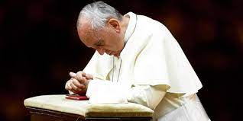
Today is
Ash Wednesday
Pope Francis has asked all of us to pray with him for peace in Ukraine

Slide 2
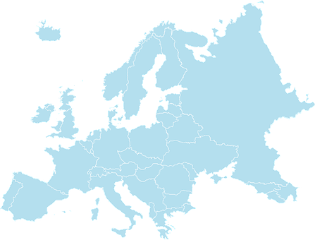
Ukraine
A prayer
for peace
in Ukraine
Ash Wednesday 2022

Slide 3
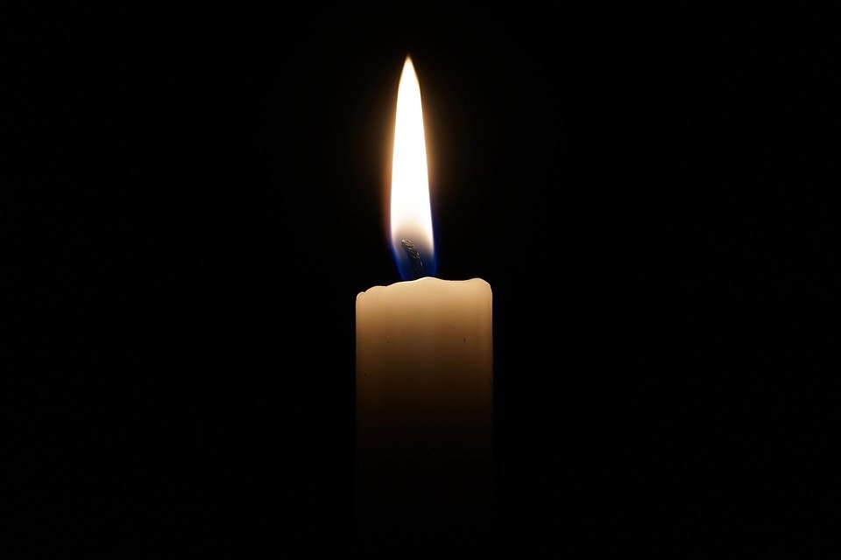
In the name of the Father
and of the Son
and of the Holy Spirit.
Amen

Slide 4
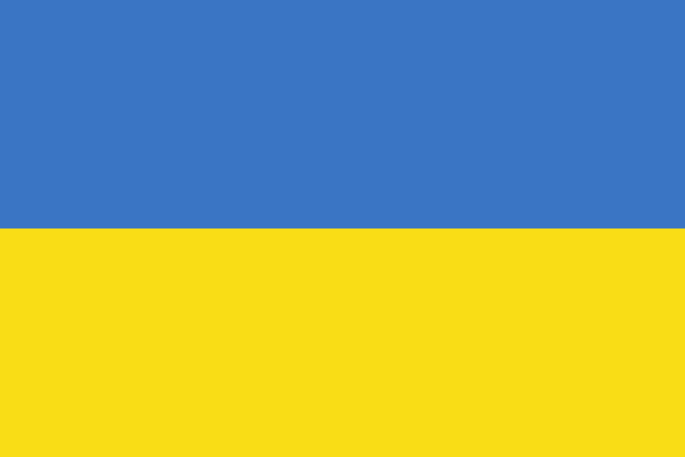
Lamb of God, you take away the sins of the world,
Have mercy on us.
Lamb of God, you take away the sins of the world,
Grant us peace.

Slide 5
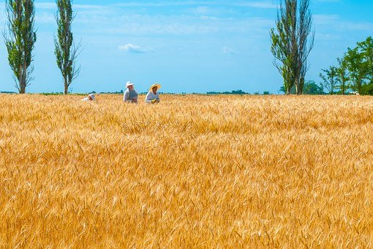
Leader: Father God, we ask you to protect the people of Ukraine as their country is under attack.
Leader: Lamb of God, you take away the sins of the world,
All: Grant us peace.

Slide 6

Leader: Loving Lord Jesus, the children of Ukraine are just like us, we pray that they may be kept safe.
Leader: Lamb of God, you take away the sins of the world,
All: Grant us peace.

Slide 7
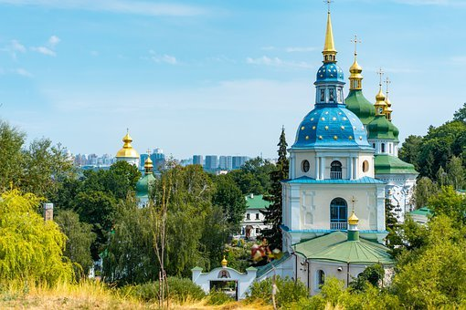
Leader: Holy Spirit, we pray for the Christians in Ukraine.
Give them courage to proclaim your peace.
Leader: Lamb of God, you take away the sins of the world,
All: Grant us peace.

Slide 8
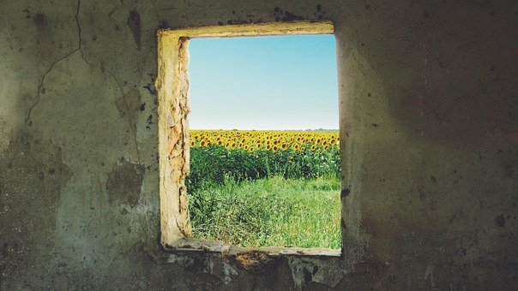
Leader: On this Ash Wednesday, as Lent begins, we pray for all those who are having to hide from violence
Leader: Lord, in your mercy
All: Hear our prayer

Slide 9
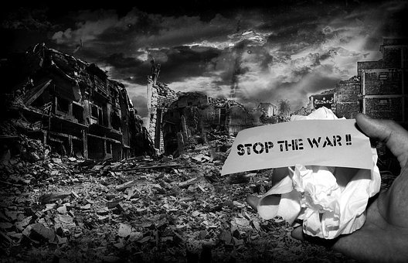
Leader: On this Ash Wednesday, as Lent begins, we pray for brave people in Russia who are protesting against the war.
Leader: Lord, in your mercy All: Hear our prayer

Slide 10
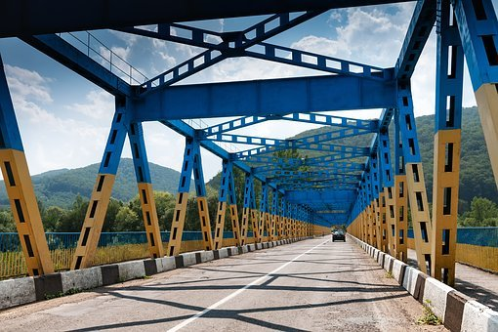
Leader: On this Ash Wednesday, as Lent begins, we pray for all those who work to build bridges towards peace.
Leader: Lord, in your mercy All: Hear our prayer

Slide 11
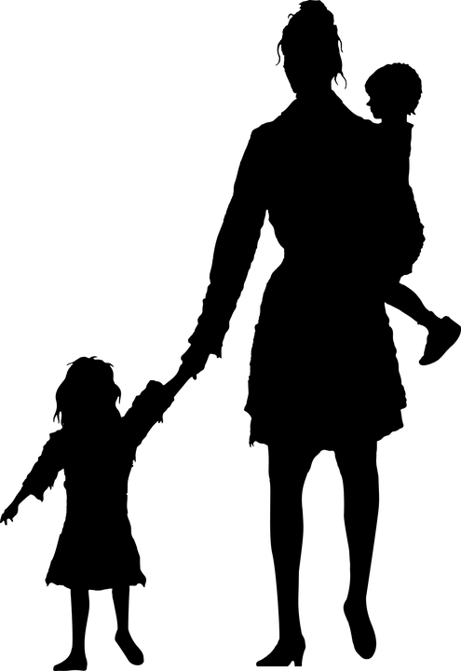
Leader: On this Ash Wednesday, as Lent begins, we pray for families who have become refugees, leaving their homes to escape the war.
Leader: Lord, in your mercy All: Hear our prayer

Slide 12
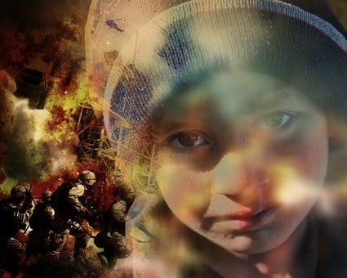
Leader: We pray for the children of Ukraine, for those who are scared, wounded, or suffering in any way as the result of the war.
Leader: Lamb of God, who takes away the sins of the world,
All: Grant us peace.

Slide 13
Let us pray
Loving Father, on this Ash Wednesday
as Lent begins, we pray for peace in Ukraine.
We pray that the people of Ukraine may feel your Spirit near to them in their suffering
We pray that leaders will call an end to fighting,
We pray that the children of Ukraine will soon know safety and peace once more.
We ask this prayer in the name of the Father, and of the Son and of the Holy Spirit. Amen

