Slide 1


A Lenten Meditation

Slide 2

Lord Jesus, when I am sad and depressed
Help me think of you praying in the garden.

Slide 3
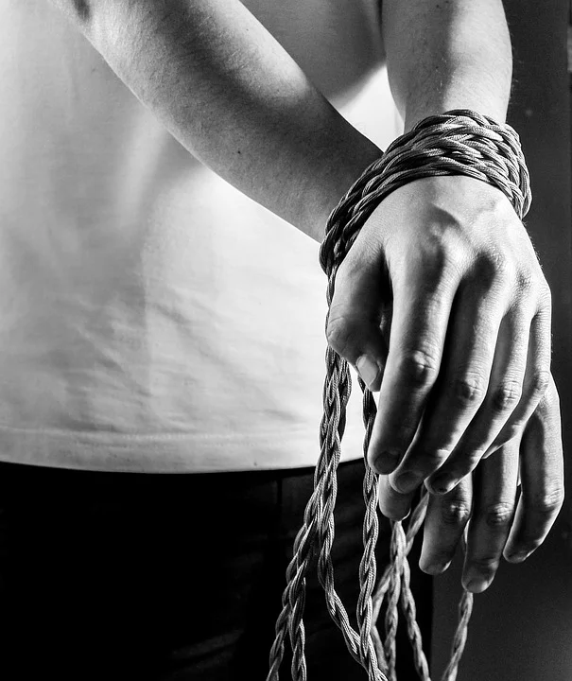
Lord Jesus, when I am fearful help me to think of you being taken prisoner.

Slide 4

Lord Jesus, when I am ill help me to think of you being scourged at the pillar.

Slide 5
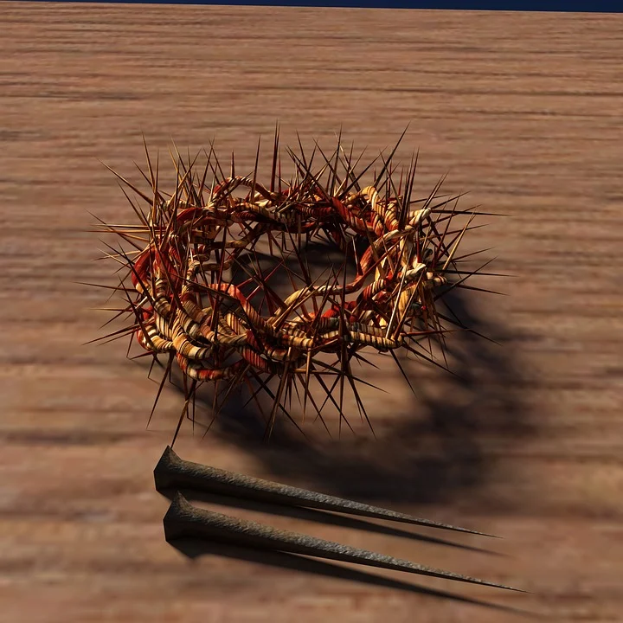
Lord Jesus, when I have a headache help me to think of you wearing the crown of thorns.

Slide 6

Lord Jesus, when I am tired help me to think of you carrying the cross for love of me.

Slide 7
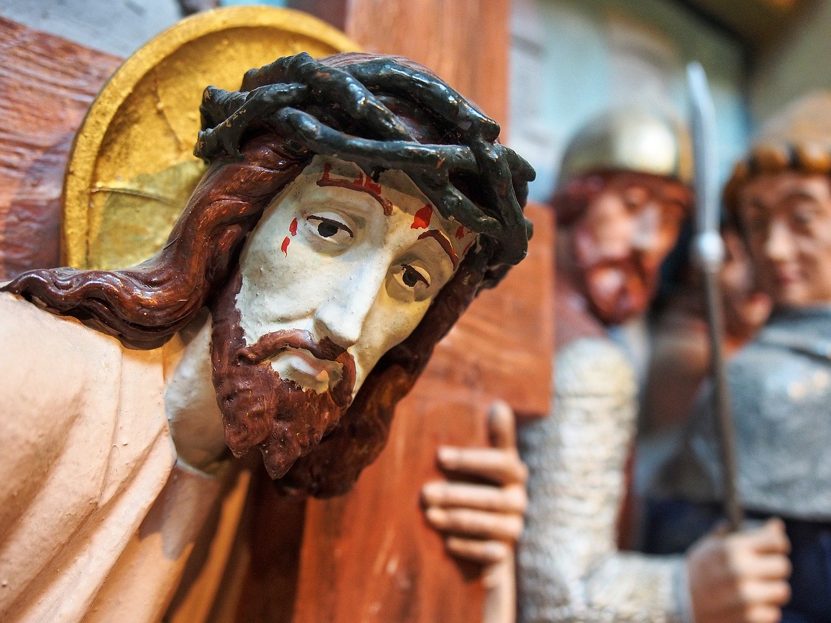
Lord Jesus, when I am humiliated help me to think of you being stripped of your garments.

Slide 8
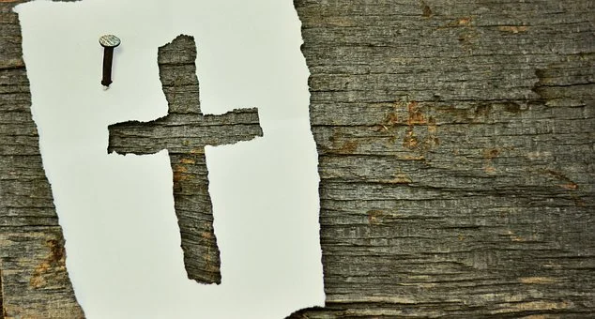
Lord Jesus, when I am in pain help me to think of you being nailed to the cross.

Slide 9
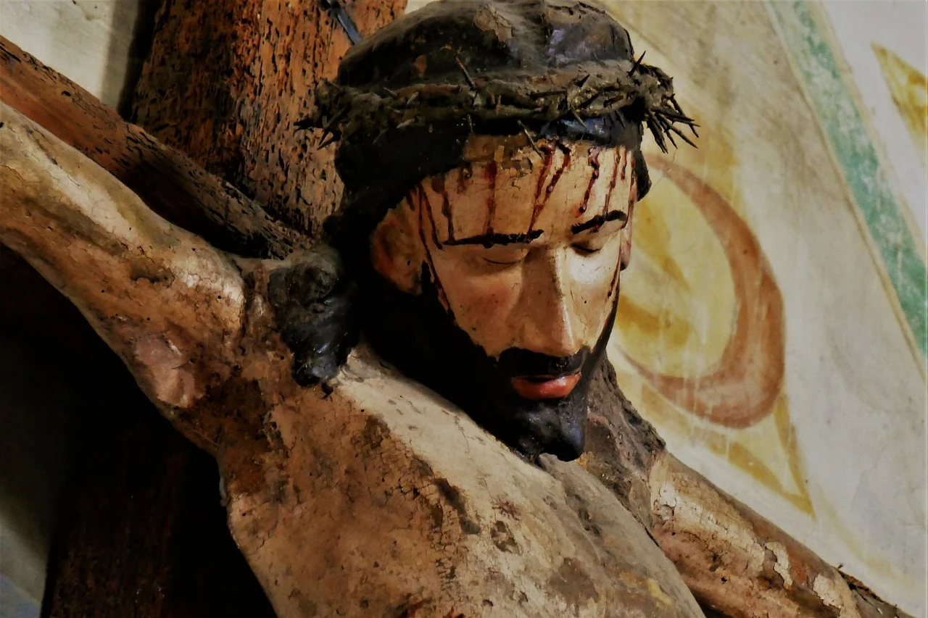
Lord Jesus, when I am lonely help me to think of you hanging on the cross.

Slide 10
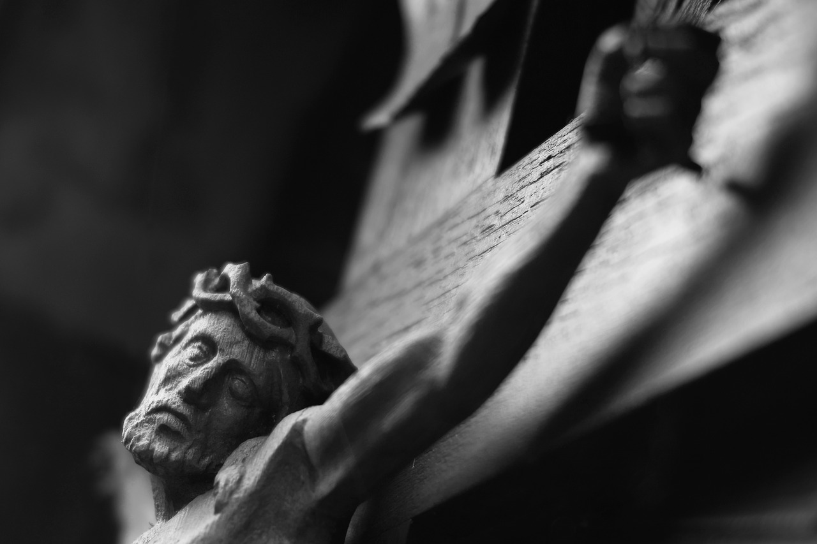
Lord Jesus, when I am dying
Help me to think of you dying on the cross for love of me.

Slide 11
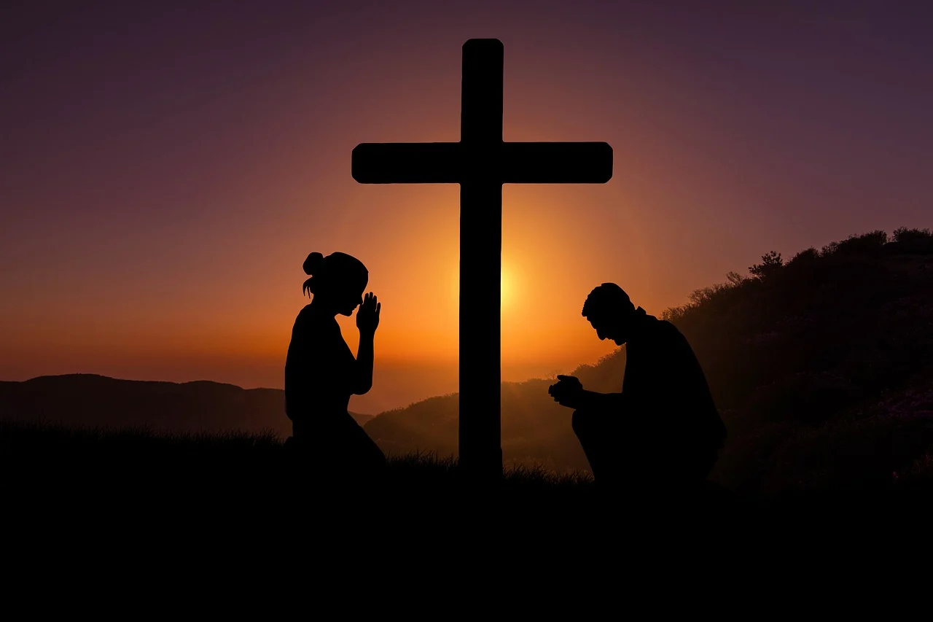
Lord Jesus, help me to remember how much you suffered for love of me and help me to love you more and more.
Amen

Slide 12

Our Father,
Who art in heaven. Hallowed be thy name.
Thy Kingdom come. Thy will be done on earth as it is in heaven.
Give us this day our daily bread and forgive us our trespasses.
As we forgive those who trespass against us
and lead us not into temptation
But deliver us from evil. Amen.
With thanks to Cafod
for sharing this Lent Meditation

