Slide 1
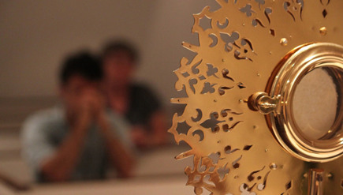
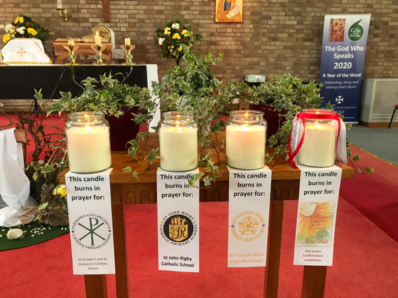
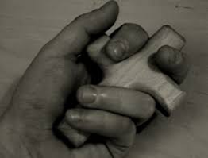
Lent 2022 –Stations of the Cross
Let us commit to pray this Lent for the Students, Staff and the Families of the
Our Lady Immaculate Catholic Academies Trust

Slide 2
We invite you to pray the Stations of the Cross today with the OLICAT Community We walk with Jesus on the road to Calvary and hold in prayer those who suffer
A Lent activity using the
OLICAT Stations of the Cross

Slide 3
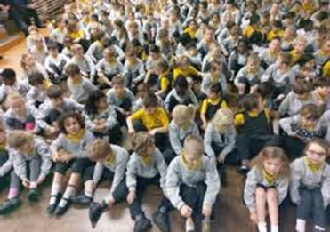
LENT 2022
1. Jesus is condemned to death Stop and pray for those who face injustice today.
We adore you, O Christ, and we bless you. R. Because, by Your holy cross, you have redeemed the world.
Let us pray
For
St John Rigby
Catholic Primary School
Bedford

Slide 4
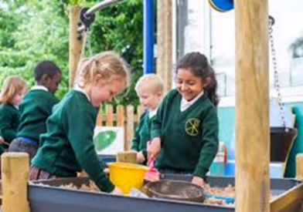
LENT 2022
2. Jesus receives the Cross Pray for anyone that you know who finds life difficult at present?
We adore you, O Christ, and we bless you. R. Because, by Your holy cross, you have redeemed the world.
Let us pray
For
St Josephs and
St Gregory's
Catholic primary
Bedford

Slide 5
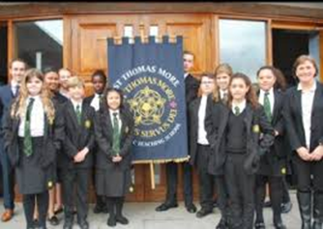
LENT 2022
3. Jesus falls for the first time Think about a situation which might have gone better? Will you try again?
We adore you, O Christ, and we bless you. R. Because, by Your holy cross, you have redeemed the world.
Let us pray
For
St Thomas More
Catholic Secondary
Bedford

Slide 6
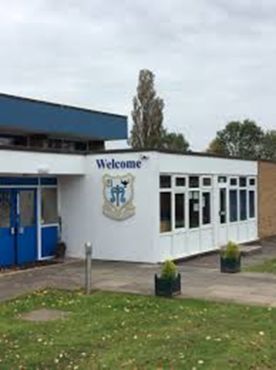
Let us pray For Our Lady of Walsingham Catholic Primary School, Corby
LENT 2022
4. Jesus is met by His Blessed Mother
We pray for Mothers who care for a sick child today We adore you, O Christ, and we bless you. R. Because, by Your holy cross, you have redeemed the world.

Slide 7
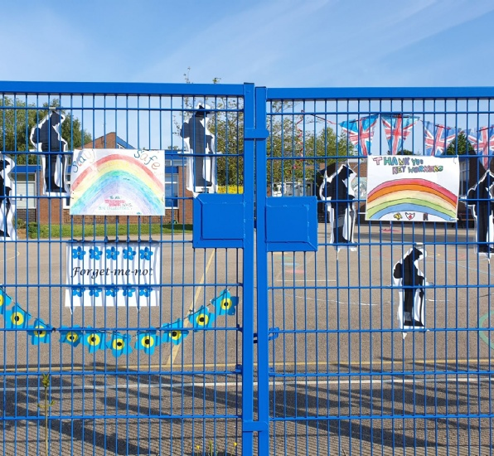
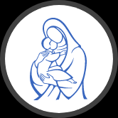
Let us pray For Our Lady’s Catholic Primary School, Wellingborough
LENT 2022
5. Simon of Cyrene helps Jesus to carry His Cross Give thanks for those people who help you every day. Who are they?
We adore you, O Christ, and we bless you. R. Because, by your holy cross, you have redeemed the world.

Slide 8
Let us pray For St Thomas More Primary School, Kettering
6. Veronica wipes the face of Jesus Is there anyone who would appreciate your help/ support today?
We adore you, O Christ, and we bless you. R. Because, by your holy cross, you have redeemed the world.
LENT 2022

Slide 9
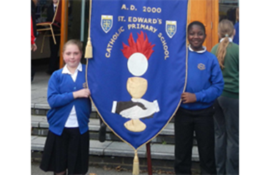
Let us pray For St Edward's Catholic Primary School, Kettering
7. Jesus falls for the second time Let us pray for the gift of perseverance and reconciliation. Can you give people/ situations a second chance?
We adore you, O Christ, and we bless you. R. Because, by your holy cross, you have redeemed the world.
LENT 2022

Slide 10
Let us pray For St Brendan's Catholic Primary School, Corby
8. The Women of Jerusalem We think of and pray for the women in our own families and women in our world who face injustice today.
We adore you, O Christ, and we bless you. R. Because, by Your holy cross, you have redeemed the world.
LENT 2022

Slide 11
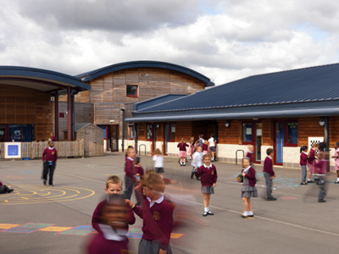
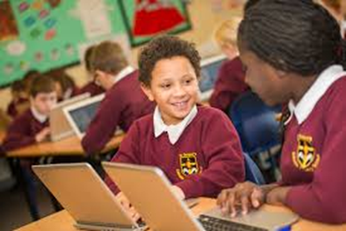
Let us pray For St Gregory's Catholic Primary School, Northampton
9. Jesus falls for the third time How many times are you prepared to try again?
We adore you, O Christ, and we bless you. R. Because, by Your holy cross, you have redeemed the world
LENT 2022

Slide 12
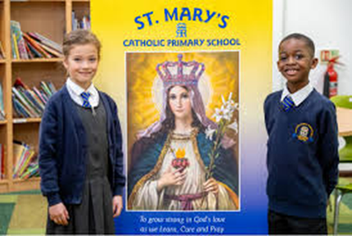
Let us pray For St Mary's Catholic Primary School, Northampton
10. Jesus is stripped of His garments How can we show concern for those unfairly treated?
We adore you, O Christ, and we bless you. R. Because, by Your holy cross, you have redeemed the world.
LENT 2022

Slide 13
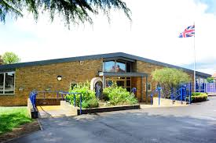
Let us pray For The Good Shepherd Catholic Primary School, Northampton
LENT 2022
11. Jesus is nailed to the Cross What does the Cross mean for you?
We adore you, O Christ, and we bless you. R. Because, by Your holy cross, you have redeemed the world

Slide 14
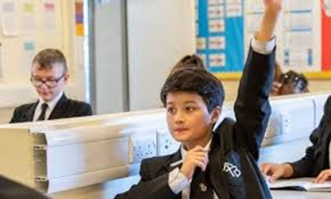
St Thomas Becket Catholic School, Northampton
LENT 2022
12. Jesus dies on the Cross Why did Jesus die?
We adore you, O Christ, and we bless you. R. Because, by Your holy cross, you have redeemed the world.

Slide 15
13. Jesus is taken down from the Cross.
How do we find hope when it seems to have gone?
We adore you, O Christ, and we bless you. R. Because, by Your holy cross, you have redeemed the world.
Let us pray
For
The OLICAT team

Slide 16
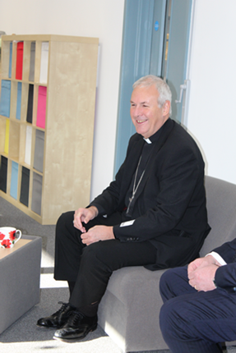
14. Jesus is placed in the Tomb Take a moment to be quiet. What can you hear? What can you see? Where are the signs of hope today? We wait to celebrate the Resurrection
We adore you, O Christ, and we bless you. R. Because, by Your holy cross, you have redeemed the world.
Let us Pray
For
The Diocese of
Northampton

