Slide 1
Instructions
The following presentation includes a short liturgy to bless your school/ classrooms at the beginning of 2022 a new school year.
You will need:
Chalk, Holy water (if available), Incense or sweet smelling fragrance .
To decide if you would like to sing the carol.
A leader (Lay Chaplain/ Senior leader) to read and take a leadership role.
A student volunteer (Chaplaincy team/ faith ambassador etc.)
5-10 minutes to conduct the liturgy.

Slide 2
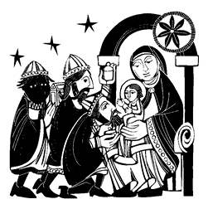
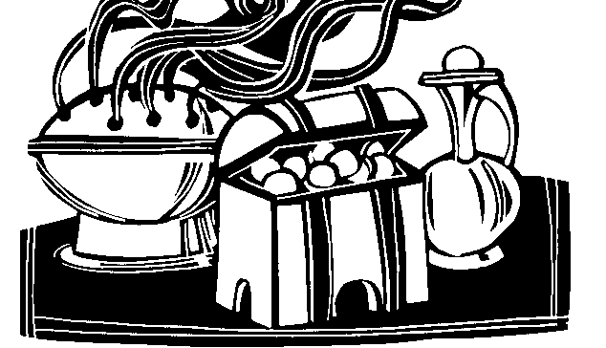
20 + C + M + B + 22 Christus Mansionem Benedicat May Christ Bless this Home

Slide 3
EPIPHANY SCHOOL BLESSING 2022
On January 6th we celebrate the arrival of the Kings the Magi in Bethlehem to worship Jesus. There is a very old tradition at this time to ask Jesus to bless our homes and schools.
We can mark the top of a door in chalk with the date, 2022.
We add the first letter of the names given to the Kings the Magi who brought presents to Jesus in his first home :
C for Caspar,
M for Melchior,
B for Balthasar.
The three letters, C-M-B, also stand for the three words of a Latin prayer :
– Christus Mansionem Benedicat = May Christ bless this house

Slide 4
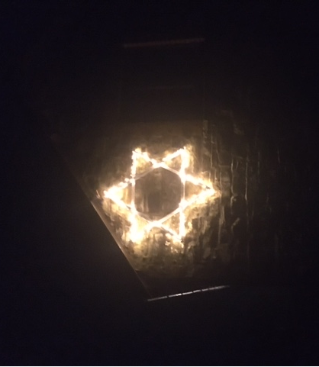
Lay Chaplain/ Senior Leader: Let us begin this liturgy to bless our school at the beginning of 2022 and make the Sign of the Cross. In the name of the Father and of the Son and of the Holy Spirit. Amen.

Slide 5
A Blessing Prayer
Lay Chaplain/ Senior Leader:
Blessed are you, Lord God of all creation: by the guidance of a star you led the magi to your child and by the light of faith you bring us to know Jesus.
Bless us as we burn this incense (scented candle), the beautiful smell reminds us of our prayerful lives offered up to you.
Bless us as we use this chalk to mark our doors in your honour.
Bless us as we sprinkle our school/class with this Holy water. We remember our Baptism.
May our school be a place in which we become like you. Amen.

Slide 6
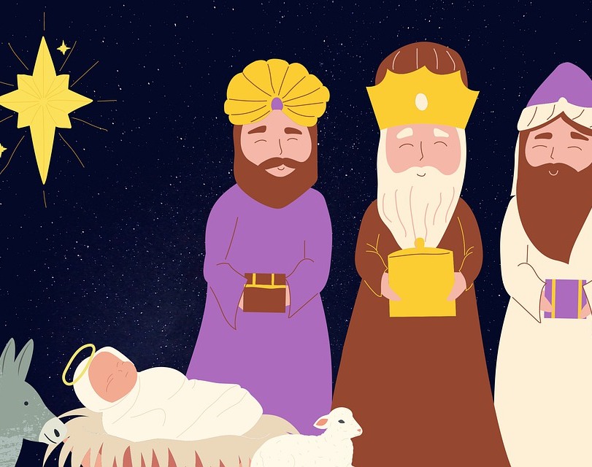
We sing together the carol
1.We three Kings of Orient are; bearing gifts we traverse afar, field and fountain, moor and mountain, following yonder star.
Chorus: O star of wonder, star of night, star with royal beauty bright, westward leading, still proceeding guide us to thy perfect light.
2. Born a King on Bethlehem plain gold I bring to crown him again, King forever, ceasing never, over us all to reign.
3. Frankincense to offer have I, Incense owns a Deity nigh. Prayer and praising, all are raising, worship him, God most high.
4. Myrrh is mine, its bitter perfume breathes a life of gathering gloom; sorrowing, sighing, bleeding, dying, sealed in the stone-cold tomb.
5. Glorious now behold him arise, King and God and sacrifice.
“Alleluia, alleluia!” earth to heaven replies.

Slide 7
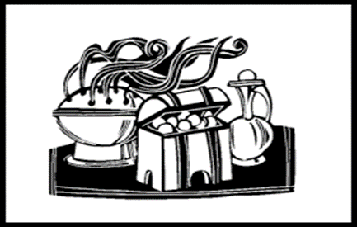
Gospel – read by Lay Chaplain or Senior Leader
A reading from St Matthews Gospel
After Jesus had been born at Bethlehem in Judaea during the reign of King Herod, some wise men came to Jerusalem from the east. 'Where is the infant king of the Jews?' they asked. 'We saw his star as it rose and have come to do him homage.' When King Herod heard this he was perturbed, and so was the whole of Jerusalem. He called together all the chief priests and the scribes of the people, and enquired of them where the Christ was to be born. 'At Bethlehem in Judaea,' they told him, 'for this is what the prophet wrote: And you, Bethlehem, in the land of Judah, you are by no means least among the leaders of Judah, for out of you will come a leader who will shepherd my people Israel.' Then Herod summoned the wise men to see him privately. He asked them the exact date on which the star had appeared, and sent them on to Bethlehem. 'Go and find out all about the child,' he said 'and when you have found him, let me know, so that I too may go and do him homage.' Having listened to what the king had to say, they set out. And there in front of them was the star they had seen rising; it went forward and halted over the place where the child was. The sight of the star filled them with delight, and going into the house they saw the child with his mother Mary, and falling to their knees they did him homage. Then, opening their treasures, they offered him gifts of gold and frankincense and myrrh. But they were warned in a dream not to go back to Herod, and returned to their own country by a different way.
The Gospel of the Lord –
All: PRAISE TO YOU, LORD JESUS CHRIST

Slide 8
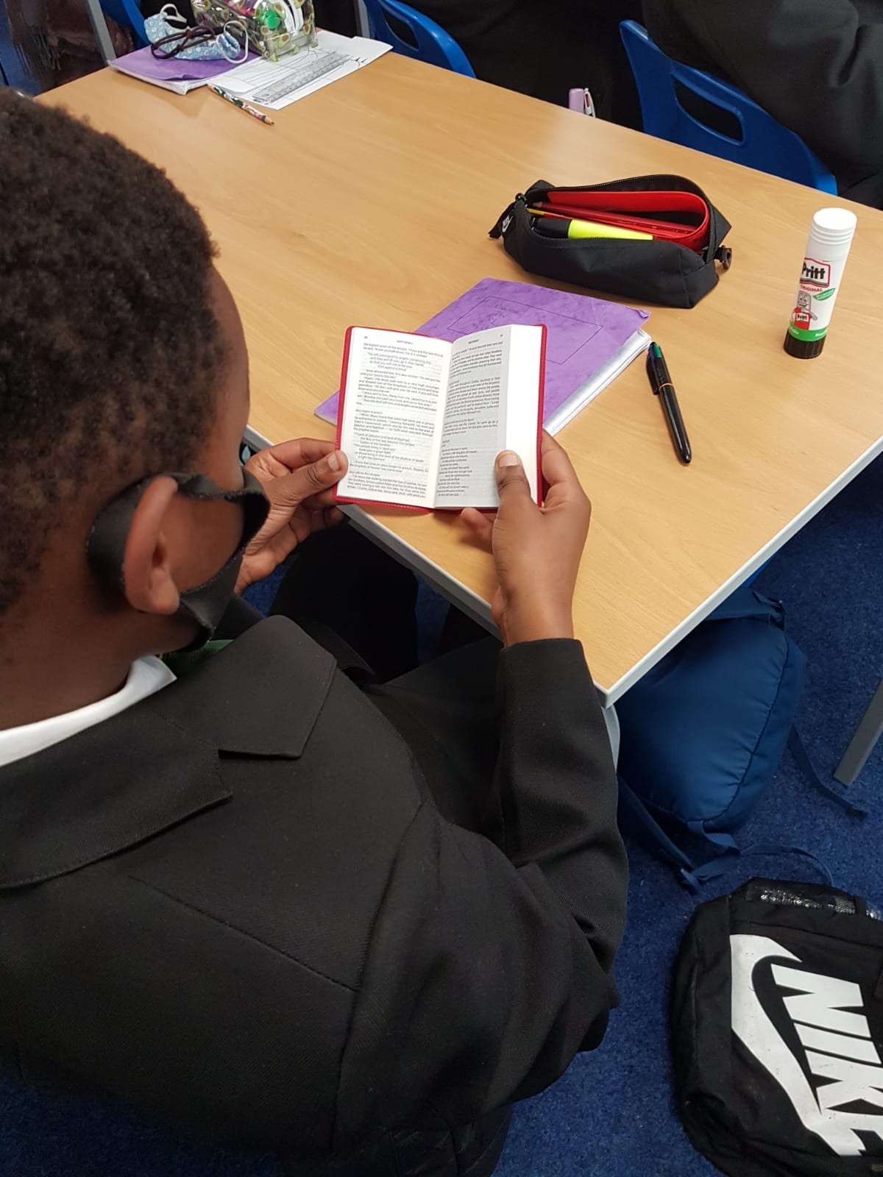
Lay Chaplain / Senior Leader:
Mark the door with 20 + C + M + B + 22. Remember that every time you come in you are asking God’s blessing on the life of your school/class in 2022. If you cannot mark the door lintel, perhaps mark the floor and/or put this card up beside or on the door.
Lord God of heaven and earth,
you revealed your only begotten Son to every nation
by the guidance of a star.
Bless this school room
and all who inhabit it.
Fill us with the light of Christ,
that our concern for others may reflect your love.
We ask this through Christ our Lord. AMEN

Slide 9
Faith Ambassador/ Junior Chaplaincy or Student representative:
Let us say together the Lord's prayer:
Our Father who art in heaven. Hallowed be thy name.
Thy Kingdom come. Thy will be done on earth as it is in heaven.
Give us this day our daily bread and forgive us our trespasses as we forgive those who trespass against us.
Lead us not into temptation but deliver us from evil.
Amen.

Slide 10
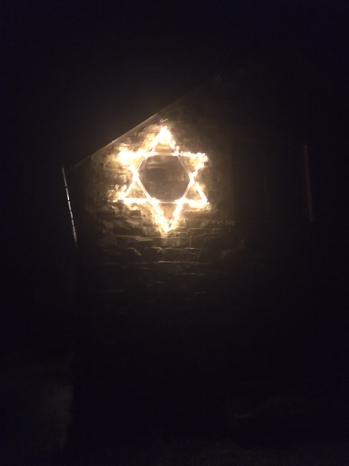
Lay Chaplain/ Senior Leader: We have blessed our school and we finish by making the sign of the Cross; In the name of the Father and of the Son and of the Holy Spirit. Amen.

Slide 11
Resources provided by NORES Diocese of Northampton
adapted by Helen Burgess, Chaplaincy Co-ordinator (Temporary)
Our Lady Immaculate Catholic Academies Trust
 | NORES - Diocese of Northampton Office for RE, Evangelisation, Catechesis & Schools SUPPORTING CATHOLIC EDUCATION AND FORMATION

